Slide 1
The Bible Mission:
An explicit revelation of God
and a sequel of God’s revelations.

Slide 2

The meaning of Revelation:
Revealing, explaining, exhibiting, expounding, defining, presenting, unveiling, opening, etc. – Various shades of God’s revelation for Mankind

Slide 3

Revelation Versus Vision:
Revelation as viewed differently from the Vision.
Vision is something you see in prayer or dream.

Slide 4

Revelation is something that God displays and demonstrates

Slide 5

Manifestation is something that God proves, establishes, and so on.

Slide 6

Creation- The first show of God’s Revelation

Slide 7

The Spirit of God was brooding over the face of the waters – Gen 1:2

Slide 8

Light and Life are the prime/first revelations of God

Slide 9

Bible Mission: The written revelation of God to St. M. Devadas in 1938

Slide 10
The need for a new revelation:
Nominality
Materialism
Lack of Holy Spirit in churches

Slide 11
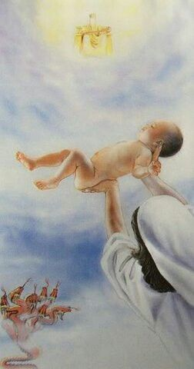
The concept of the Bride-Church:
The male child of the woman clothed in sun(Rev. 12: 1-5)

Slide 12

Biblical view of God’s revelations:
Entering of Sin, Starting of Revelation

Slide 13

New clothes, New births, New living, New knowledge, New Flourishing

Slide 14
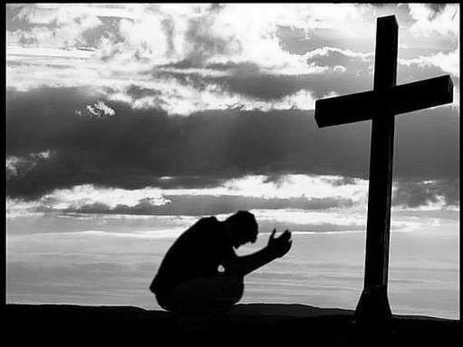
As the Sin grew up the revelations much multiplied

Slide 15
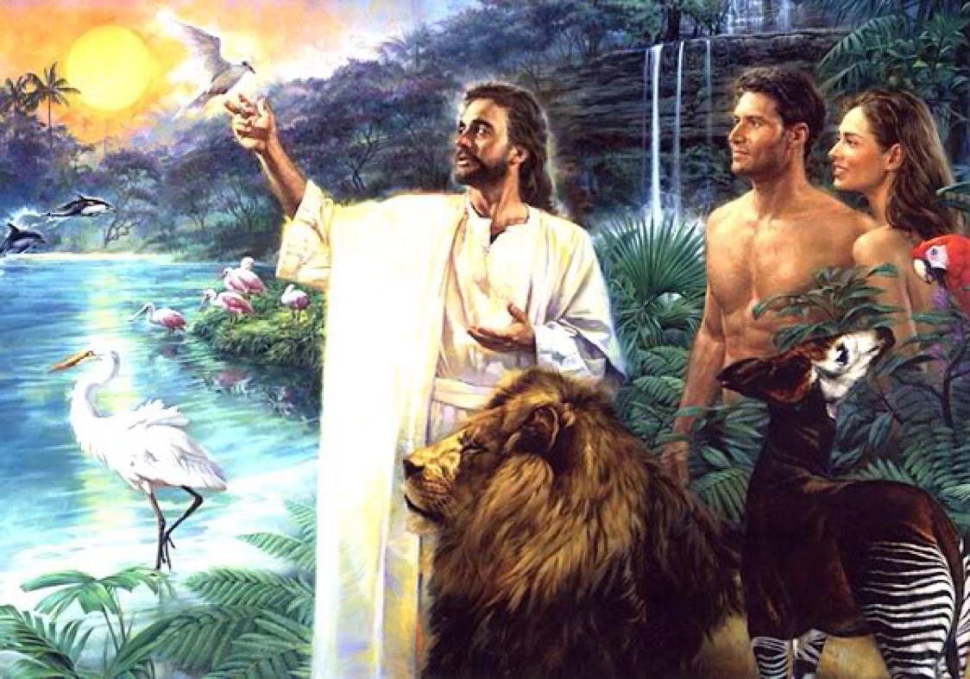
God using Adam to impart His revelations to his succeeding Generation

Slide 16

God revealing the secret of His ultimate intimate fellowship to Enoch

Slide 17
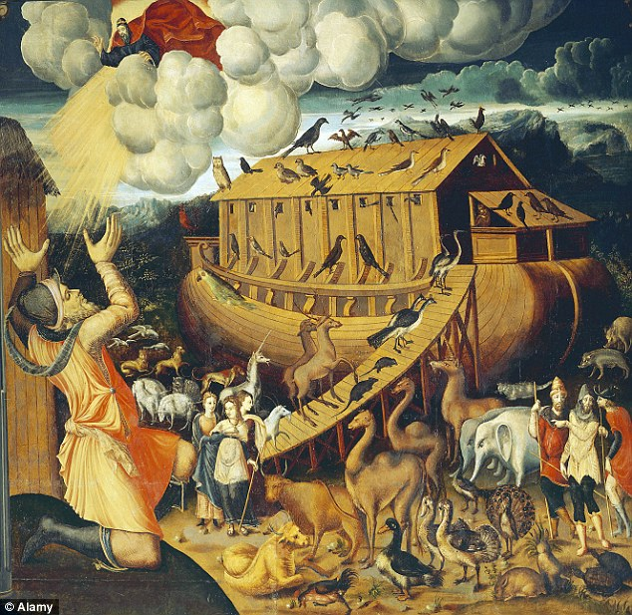
God revealing Noah about the great Ark

Slide 18
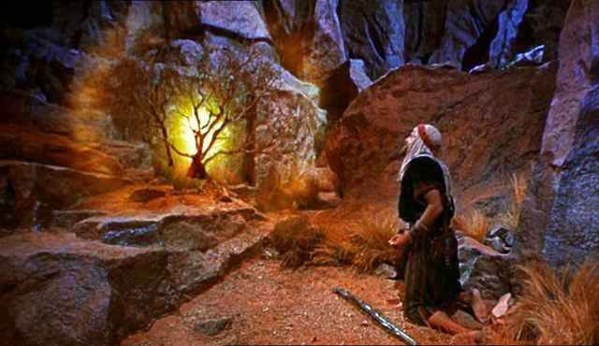
God revealing Abraham of the Promised land and the great “city” with permanent foundations. Heb 11:10

Slide 19
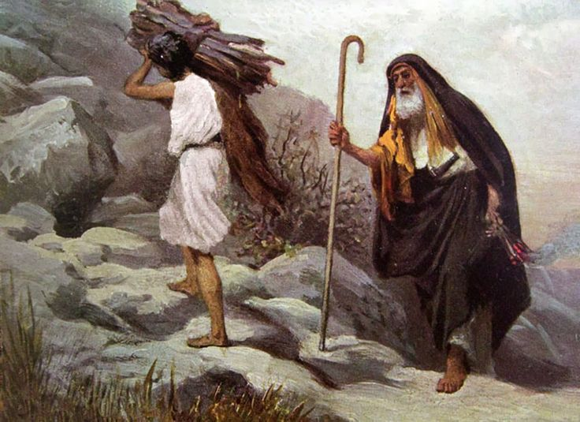
God revealing Joseph, Jacob and Isaac

Slide 20
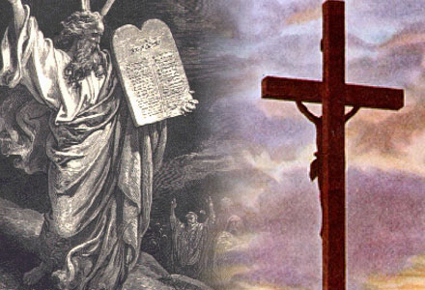
God revealing law to Moses

Slide 21
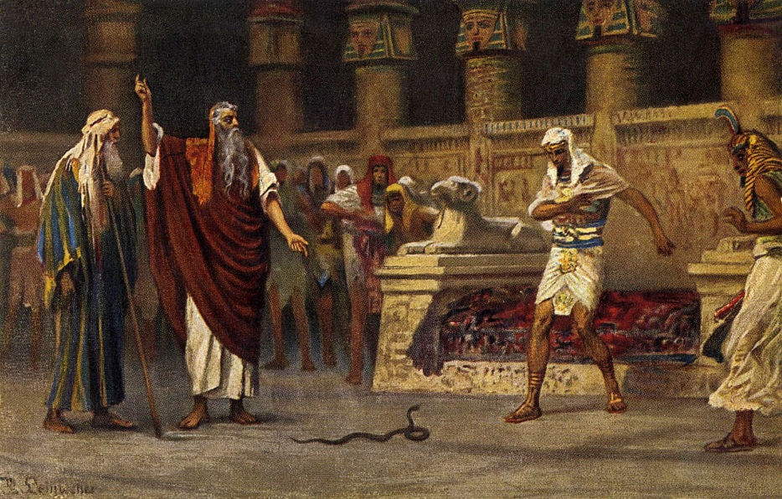
God revealing to Patriarchs
God revealing His priesthood through Aaron

Slide 22
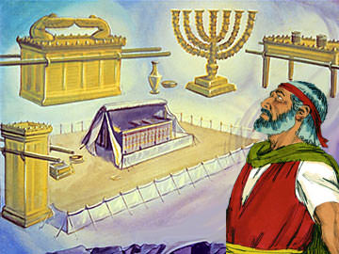
God revealing His dwelling through the Tabernacle, and all the holy articles

Slide 23
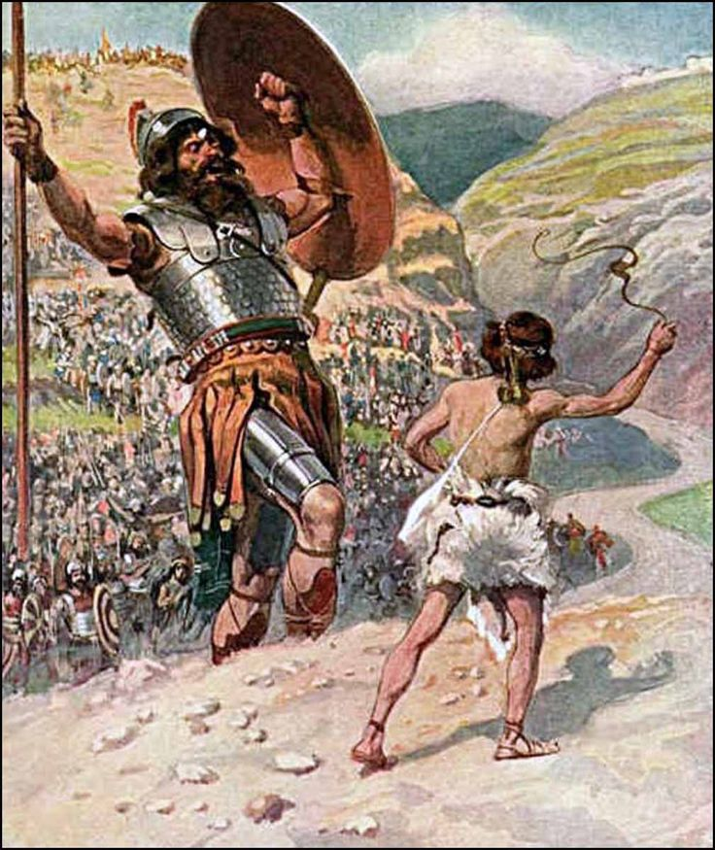
God’s manifold revelations to King David

Slide 24
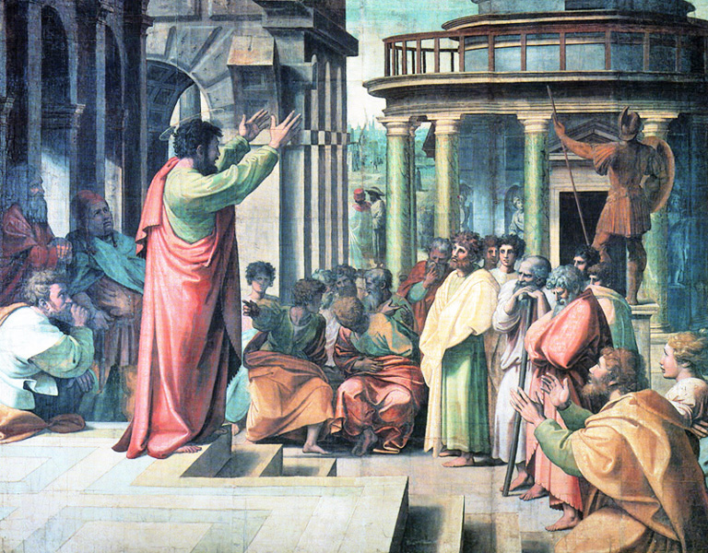
God’s revelations in New Testament
God revealing His secrets to St. Paul (Rom 16: 25-27)

Slide 25
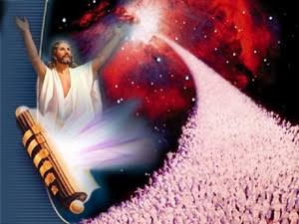
Culmination of all of God’s revelations
God’s conclusion of His Church period, and His period of Grace

Slide 26
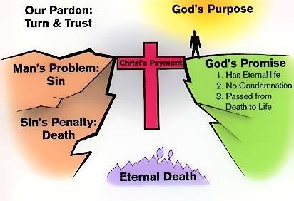
God’s summation of His plan of Salvation
Note: All denominations were established as per the leading of the Lord to holy men of various times. But the Bible Mission was His direct, distinct revelation to St. M Devadas in 1938

Slide 27
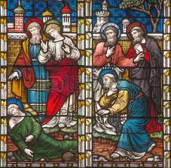
All the experiences of the Biblical saints are brought into experience of BM. (The mysterious gifts and revelations and experiences manifested in early BM)

Slide 28
The essence of biblical teaching which was hinted by our Lord as “ All Truth” (John 16:13)
The unification of all the Universal Churches, to form the Bride-Church from among the Universal Church

Slide 29
The epitome of God’s favour, in contrast with His love and Grace.
Father – Love
Son – Grace
Holy Spirit - Favour

Slide 30
The fulfilment of God’s mystery (Rev 10:7) that was revealed in the 66 books of the Holy Bible.
“BIBLE MISSION:” Mission of the Bible i.e its meaning, purpose, plan and course of events; is the prime element of culmination in BM
The TWO EYES of BIBLE MISSION : THE SONG OF SONGS AND THE BOOK OF REVELATION

Slide 31

Conclusions:
God’s particular Promises given to the Bible Mission.
God’s revelation of Mid-Air, shall take BM to all the places wherever it is present.

Slide 32
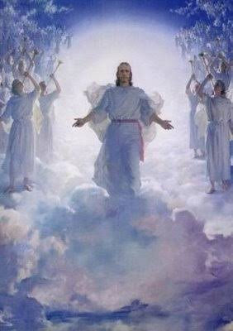
The shade and glory of the rapture cloud of Shekina is promised in Bible Mission
Maranatha is the banner of Bible Mission. Come Lord Jesus is its Flag.

